Slide 1
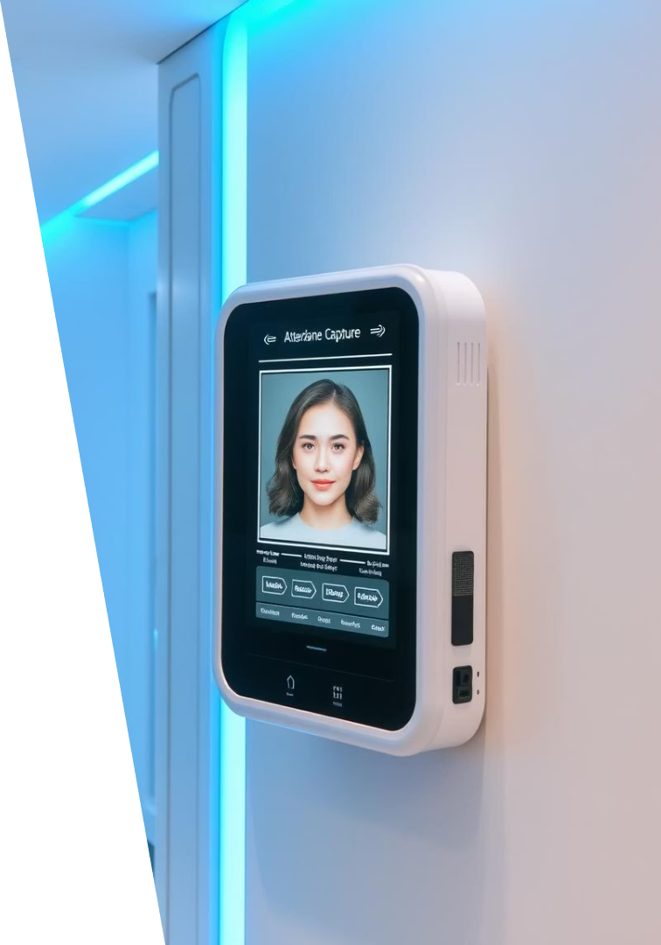
Face Recognition Plus Attendance Capture App
This app automates attendance using advanced face recognition technology.
It eliminates manual attendance marking, reducing errors and fraud risks.

Slide 2
Introduction and Problem Statement
Overview
Problem Statement
Automates attendance via face recognition.
Manual attendance is slow and prone to proxy faults.
Removes manual errors and fraud opportunities.
Need a touchless, secure, efficient system.

Slide 3
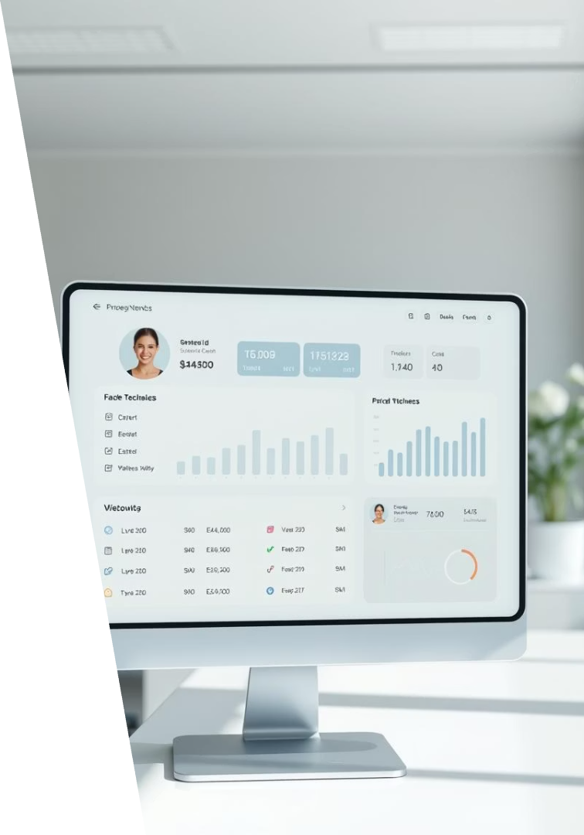
Project Objectives
Real-time Recognition
Data Security
Instantly identify faces and mark attendance.
Ensure safe storage and easy retrieval of records.
User Interface
Simple, intuitive design for admins and users.

Slide 4

Literature Review and Research Gap
Background
Face recognition uses machine learning and computer vision.
Common in security and workforce systems.
Research Gap
Many apps lack real-time processing.
Limited anti-spoofing and open-source tailored solutions.

Slide 5
Methodology and Tools
Tools
Approach
Python with OpenCV, face_recognition, NumPy
Encode known face images
CSV files for data storage
Capture live video and detect faces
Standard webcams
Log attendance with timestamps

Slide 6
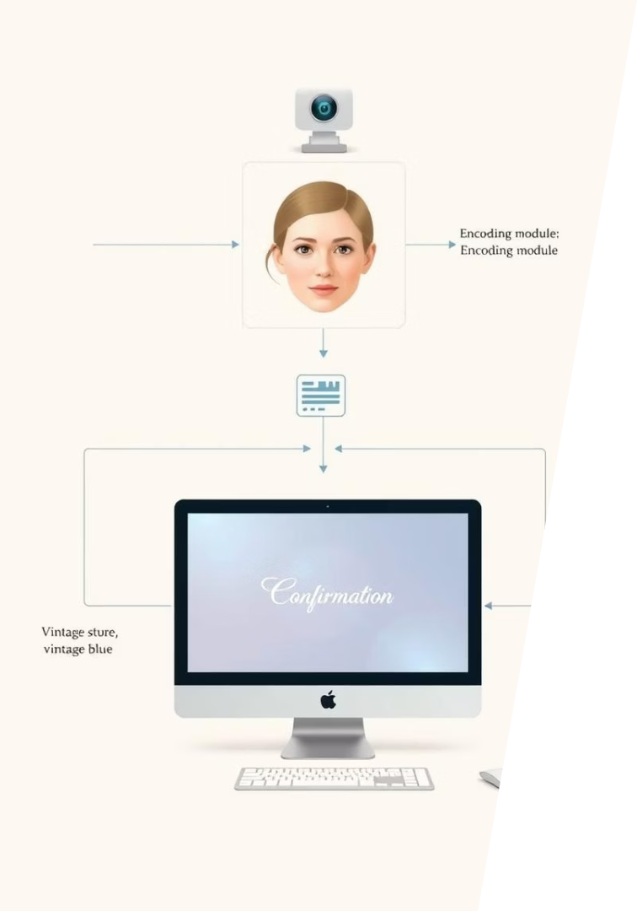
System Design and Architecture
Load and Encode Faces
Capture Video Stream
Detect and Recognize Faces
Mark Attendance in CSV

Slide 7
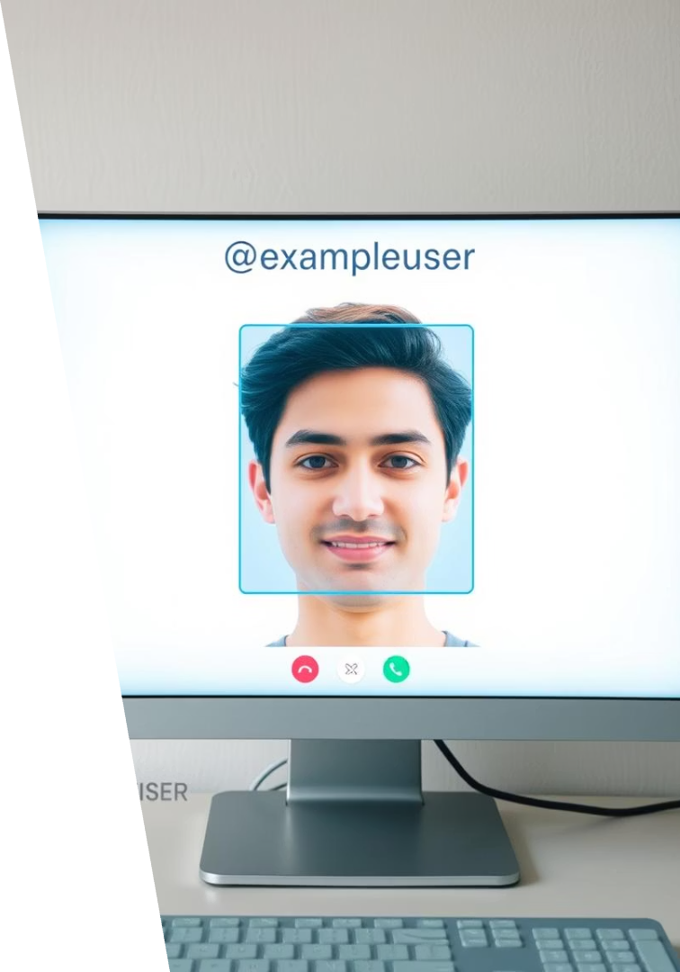
Implementation Highlights
1
Face Recognition
2
Attendance Logging
Real-time recognition with <1 second latency.
Automatic marking using CSV file.
3
User Interface
Live video with clear bounding boxes and names.

Slide 8
Results and Limitations
Results
Challenges
Accurate attendance for registered users
Lighting and camera quality impact accuracy
Fast, seamless logging
Spoofing not prevented without anti-spoofing
Reduced proxy attendance
CSV limits scalability; databases recommended

Slide 9
Future Scope and Conclusion
Future Enhancements
Key Takeaways
Liveness detection for anti-spoofing
Face recognition improves attendance accuracy and efficiency.
Secure cloud databases
Mobile app integration
Reduces errors and proxy attendance significantly.
Support multi-face and group attendance
Future work will boost security and scalability.

